Slide 1
Parallel Computing for Science & Engineering SSC 374/394c Introduction to Parallel Computing
Instructors:
Victor Eijkhout, Research Scientist, TACC
Kent, Milfeld, Research Associate, TACC

Slide 2
Outline
Overview
Theoretical background
Parallel computing systems
Parallel programming models
MPI/OpenMP examples

Slide 3
OVERVIEW

Slide 4
What is Parallel Computing?
Parallel computing: use of multiple processors or computers working together on a common task.
Each processor works on part of the problem
Processors can exchange information

Slide 5
The basic idea
Spread operations over many processors
If n operations take time t on 1 processor,
Does this become t/p on p processors (p<=n)?
for (i=0; i<n; i++)
a[i] = b[i]+c[i]
a = b+c
Idealized version: every process has one array element
Notes:
5

Slide 6
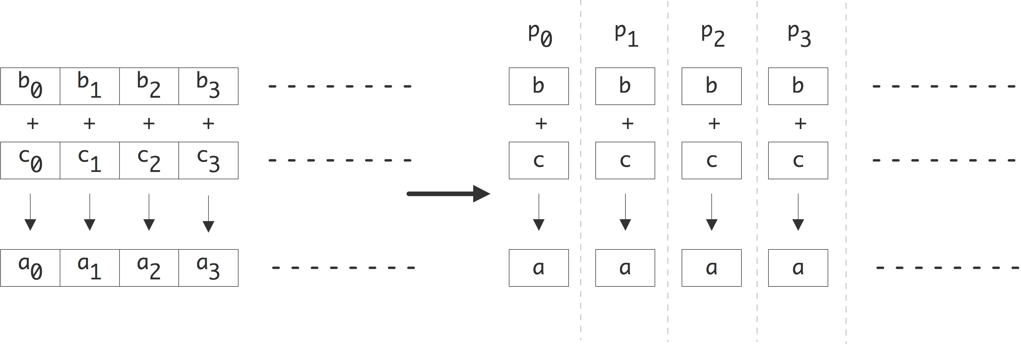

Slide 7
The basic idea
Spread operations over many processors
If n operations take time t on 1 processor,
Does this become t/p on p processors (p<=n)?
for (i=0; i<n; i++)
a[i] = b[i]+c[i]
Idealized version: every process has one array element
a = b+c
for (i=my_low; i<my_high; i++)
a[i] = b[i]+c[i]
Slightly less ideal: each processor has part of the array
Notes:
7

Slide 8
The basic idea (cont’d)
Spread operations over many processors
If n operations take time t on 1 processor,
Does it always become t/p on p processors (p<=n)?
s = sum( x[i], i=0,n-1 )
Notes:
8

Slide 9
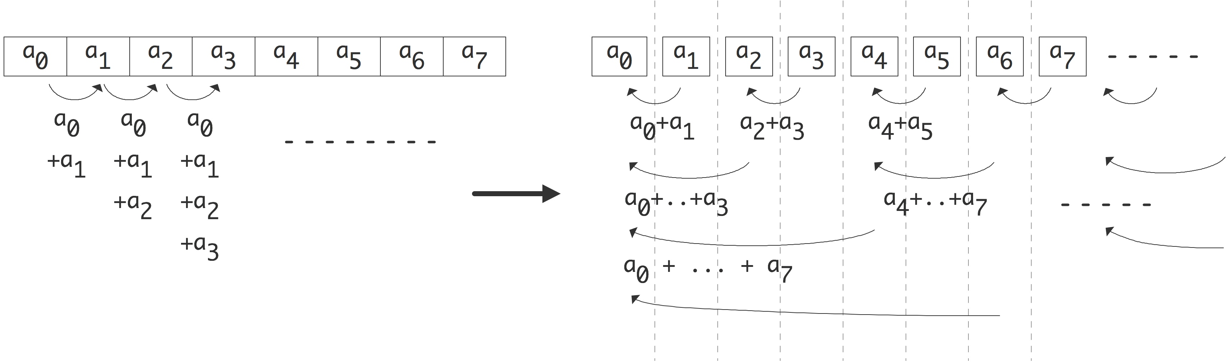

Slide 10
The basic idea (cont’d)
Spread operations over many processors
If n operations take time t on 1 processor,
Does it always become t/p on p processors (p<=n)?
s = sum( x[i], i=0,n-1 )
Conclusion: n operations can be done with n/2 processors, in total time log₂n
Theoretical question: can addition be done faster?
Practical question: can we even do this?
for (p=0; p<n/2; p++)
x[2p,0] = x[2p]+x[2p+1]
for (p=0; p<n/4; p++)
x[4p,1] = x[4p]+x[4p+2]
for ( .. p<n/8 .. )
Et cetera
Notes:
10

Slide 11
THEORETICAL BACKGROUND

Slide 12
Speedup & Parallel Efficiency
Speedup:
p = # of processors
Ts = execution time of the sequential algorithm
Tp = execution time of the parallel algorithm with p processors
Sp= P (linear speedup: ideal)
Parallel efficiency
super-linear speedup
Sp
linear speedup
normal speedup
# of processors

Slide 13
Limits of Parallel Computing
Theoretical Upper Limits
Amdahl’s Law
Practical Limits
Load balancing
Non-computational sections
Other Considerations
time to re-write code

Slide 14
Amdahl’s Law
All parallel programs contain:
parallel sections (we hope!)
serial sections (unfortunately)
Serial sections limit the parallel effectiveness
Amdahl’s Law states this formally
Effect of multiple processors on speed up
where
f_{s} = serial fraction of code
f_{p} = parallel fraction of code
P = number of processors

Slide 15
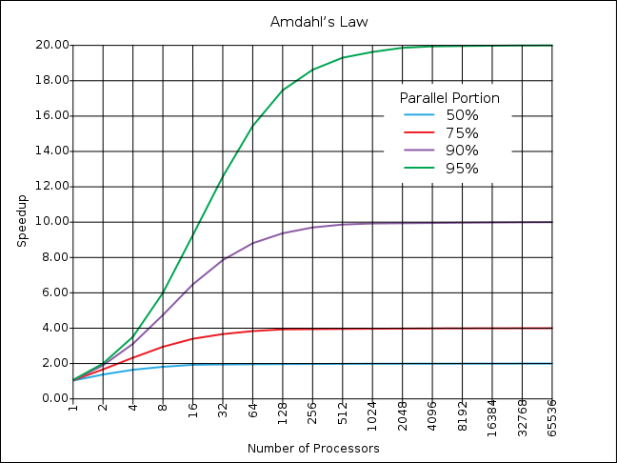
Amdahl’s Law

Slide 16
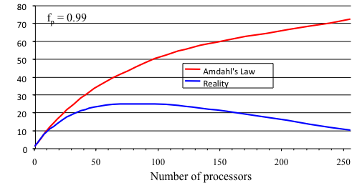
Practical Limits: Amdahl’s Law vs. Reality
In reality, the situation is even worse than predicted by Amdahl’s Law due to:
Load balancing (waiting)
Scheduling (shared processors or memory)
Cost of Communications
I/O
Sp

Slide 17
Gustafson’s Law
Effect of multiple processors on run time of a problem with a fixed amount of parallel work per processor.
α is the fraction of non-parallelized code where the parallel work per processor is fixed (not the same as f_{p} from Amdahl’s)
P is the number of processors

Slide 18
Comparison of Amdahl and Gustafson
Amdahl : fixed work
Gustafson : fixed work per processor
cpus 1 2 4
cpus 1 2 4

Slide 19
Scaling: Strong vs. Weak
We want to know how quickly we can complete analysis on a particular data set by increasing the PE count
Amdahl’s Law
Known as “strong scaling”
We want to know if we can analyze more data in approximately the same amount of time by increasing the PE count
Gustafson’s Law
Known as “weak scaling”

Slide 20
PARALLEL SYSTEMS

Slide 21
Classification #1: instruction streams

Slide 22
“Old school” hardware classification
SISD old-fashioned (von Neumann) one-instruction-at-a-time
SIMD array processors, vector pipelines, SSE/AVX instructions
MIMD every processor its own data and instruction stream
SPMD like MIMD, but all the same executable
SIMT like SIMD, but not entirely synchronized: GPUs

Slide 23
Classification #2: memory model

Slide 24
Shared and distributed memory
All processors have access to a pool of shared memory
Access times vary from CPU to CPU in NUMA systems
Example: SGI Altix (SMP), multicore processors
Memory is local to each processor
Data exchange by message passing over a network
Example: Clusters with single-socket blades
M
M
M
M
M
Memory
P
P
P
P
P
P
P
P
P
P
Network

Slide 25
Hybrid systems
Memory
Memory
Memory
Memory
Memory
Network
A limited number, N, of processors have access to a common pool of shared memory
To use more than N processors requires data exchange over a network
Example: Cluster with multi-socket blades

Slide 26
Multi-core systems
Memory
Memory
Memory
Memory
Memory
Network
Extension of hybrid model
Communication details increasingly complex
Cache access
Main memory access
Quick Path / Hyper Transport socket connections
Node to node connection via network

Slide 27
Co-processor Systems
Memory
Memory
Memory
Memory
GPU
GPU
GPU
GPU
Network
Calculations made in both CPUs and co-processors (GPU, MIC)
Programmability is tricky: two different processor types
Requires specific libraries and compilers (GPU: CUDA, OpenCL, MIC: OpenMP)

Slide 28
Classification #3: process dynamism

Slide 29
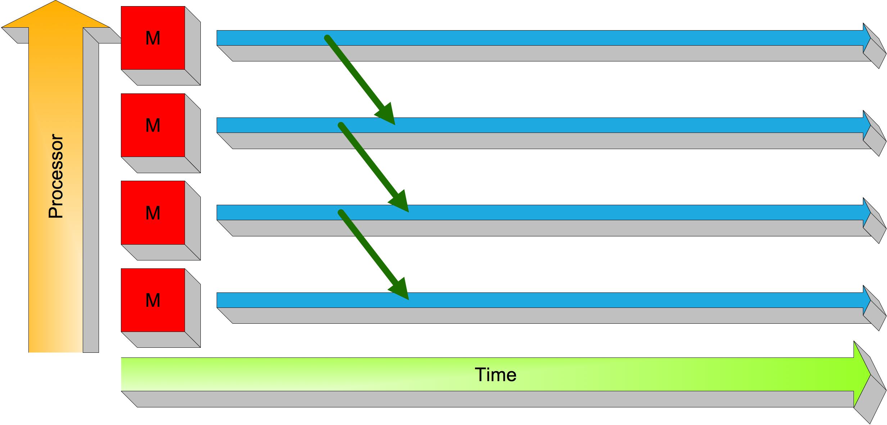
“Process-based” parallelism
MIMD & SPMD: one process per processor/core, lives for the life of the run
Great for distributed memory: task creation and migration is hard.

Slide 30
Single Program Multiple Data
SPMD: dominant programming model for shared and distributed memory machines.
One source code is written
Code can have conditional execution based on which processor is executing the copy
All copies of code start simultaneously and communicate and sync with each other periodically
MPMD: not often used (climate models), kinda tricky

Slide 31
SPMD Model
source.c
source.c
source.c
source.c
source.c
processor 0
processor 1
processor 2
processor 3
Network

Slide 32
Data Decomposition
For distributed memory systems, the ‘whole’ grid or sum of particles is decomposed to the individual nodes
Each node works on its section of the problem
Nodes can exchange information
Grid of Problem to be solved
Node #1 works on this area
of the problem
Node #2 works on this area
of the problem
exchange
y
exchange
Node #3 works on this area
of the problem
exchange
Node #4 works on this area
of the problem
exchange
x

Slide 33
Typical Data Decomposition
Example: integrate 2-D propagation problem:
Starting partial
differential equation:
Finite Difference
Approximation:
PE #0
PE #1
PE #2
PE #3
y
PE #4
PE #5
PE #6
PE #7
x

Slide 34
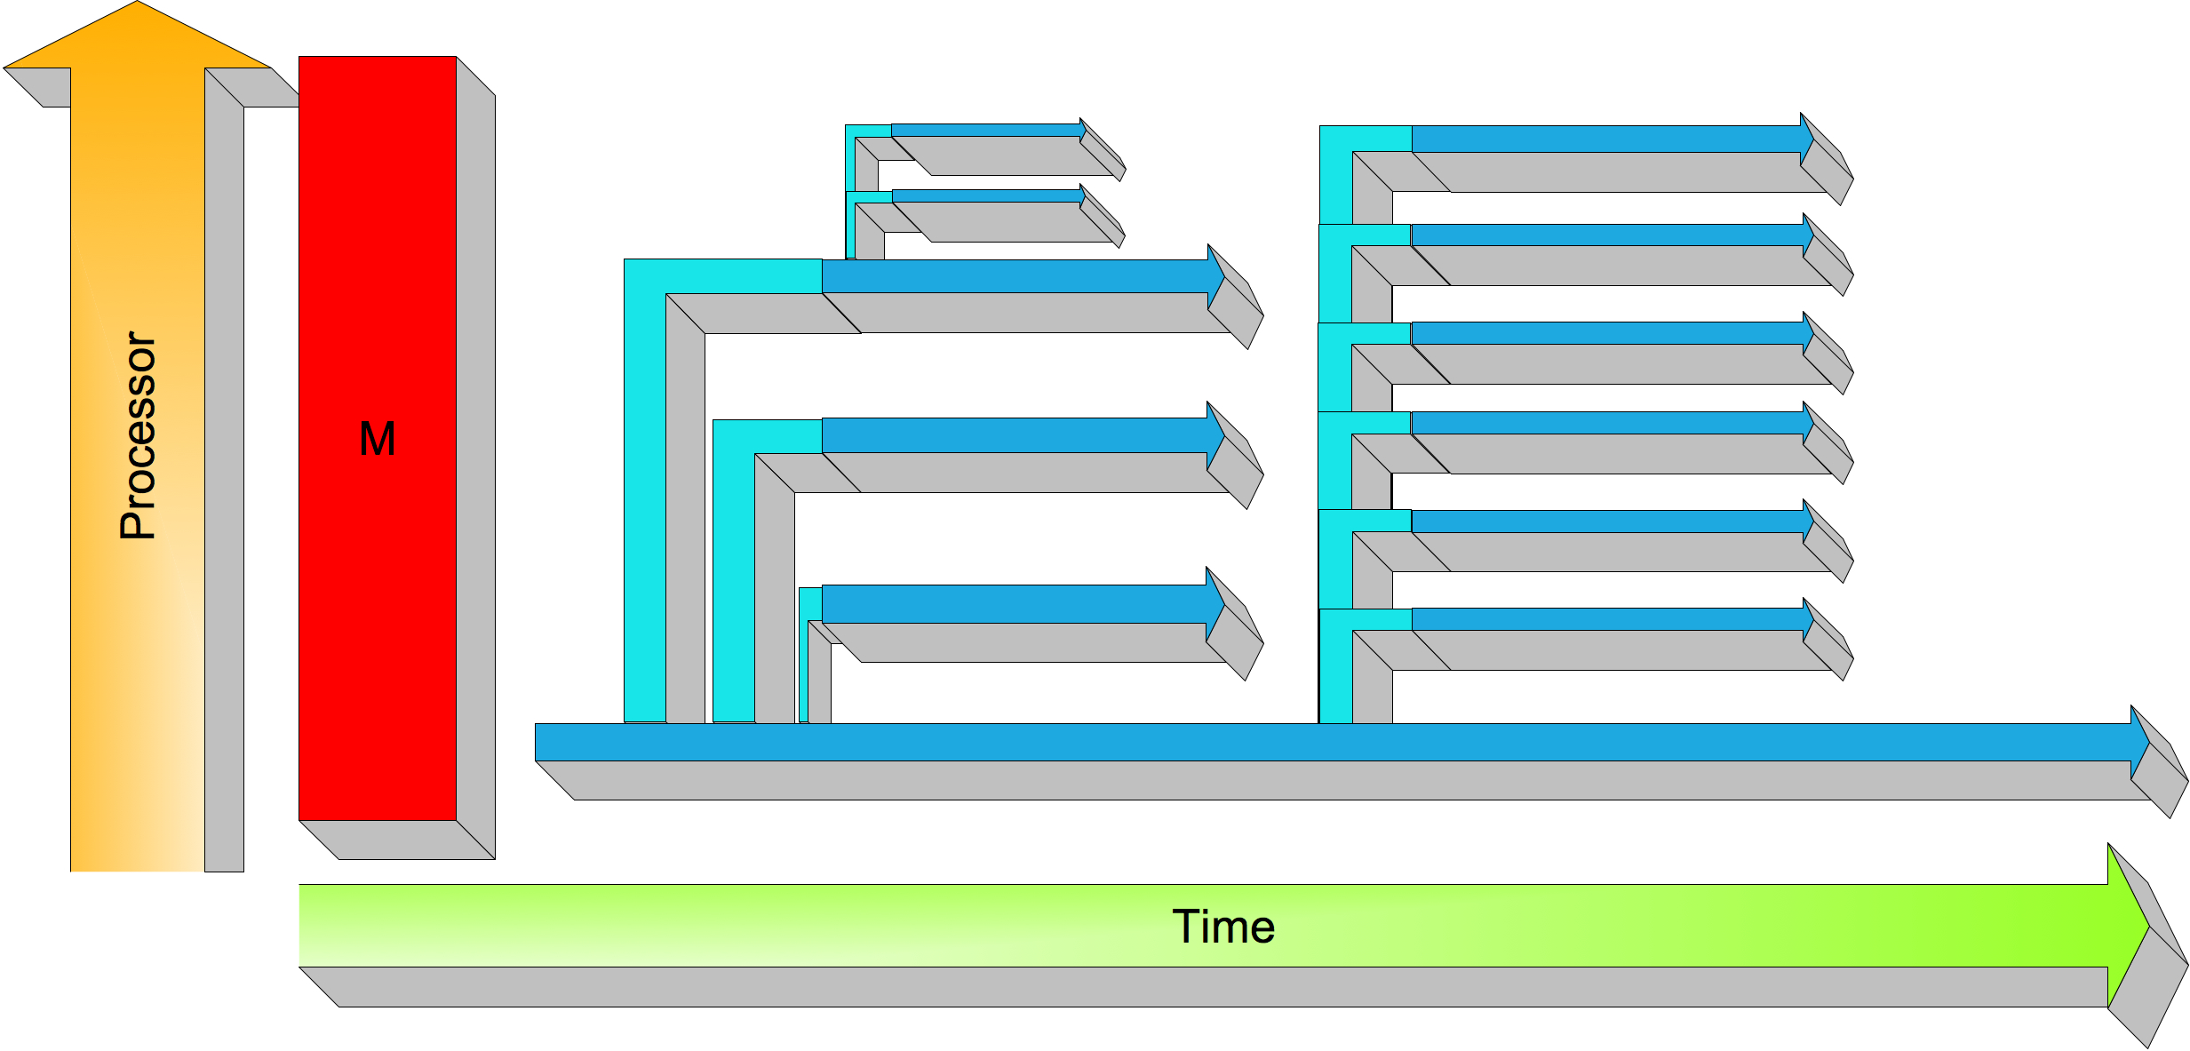
“Task-based” parallelism
Threading models: tasks can be created at will, placed on whatever processor/core is free
Great on shared memory

Slide 35
Dynamic thread creation
Old: pthreads
Newer: Cilk+ (Intel), OpenMP (open standard)
int sum=0;
void adder(){sum = sum+1;}
int main() {
int i;
pthread_t threads[NTHREADS];
for (i=0; i<NTHREADS; i++)
pthread_create
(threads+i,NULL,&adder,NULL);
for (i=0; i<NTHREADS; i++)
pthread_join(threads[i],NULL);
cilk int fib(int n){
if (n<2) return 1;
else {
int rst=0;
rst += spawn fib(n-1);
rst += spawn fib(n-2);
sync;
return rst;
}

Slide 36
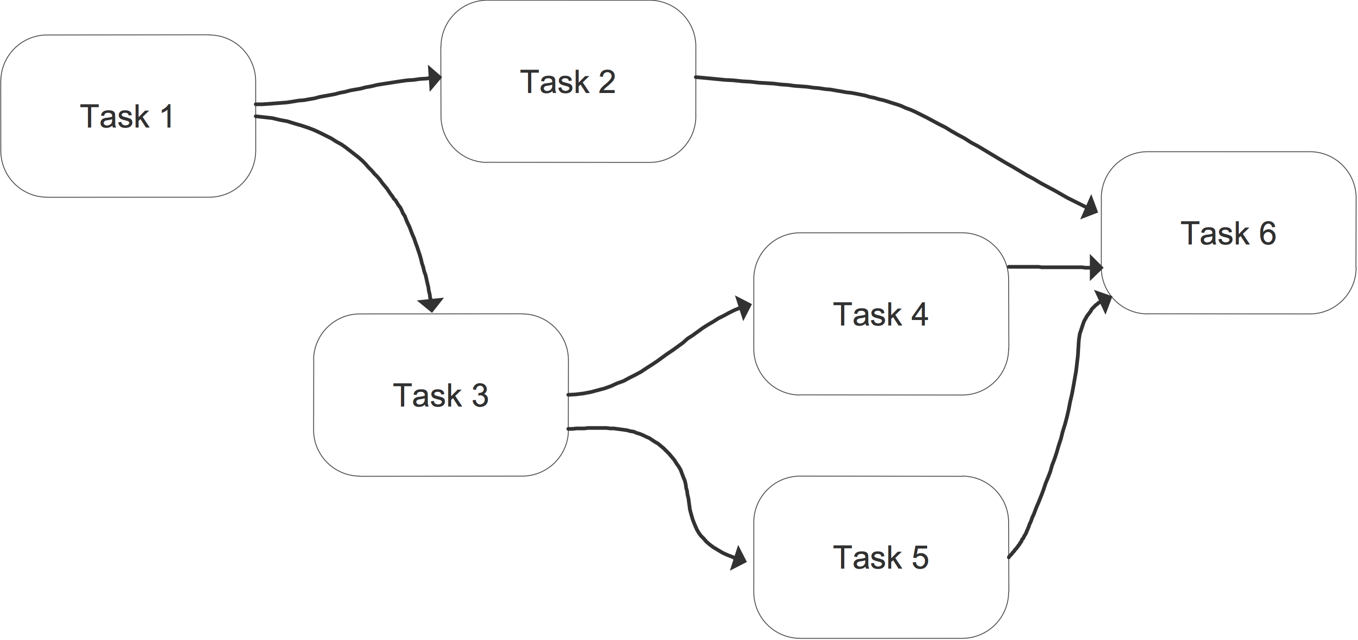
General tasks
Can be realized with OpenMP tasks
Dedicated task graph packages: CnC, Quark, SuperMatrix,….

Slide 37
OpenMP Example: Parallel Loop
!$OMP PARALLEL DO
do i=1,128
b(i) = a(i) + c(i)
end do
!$OMP END PARALLEL DO
Easy parallelism: tasks correspond to loop iterations
(Actually, tasks are groups of iterations)
The first directive specifies that the loop immediately following should be executed in parallel. The second directive specifies the end of the parallel section (optional).
For codes that spend the majority of their time executing the content of simple loops, the PARALLEL DO directive can result in significant parallel performance.
OpenMP also has a general task mechanism

Slide 38
Different world views

Slide 39
Shared memory data access
One code will run on 2 CPUs
Program has array of data to be operated on by 2 CPUs so array is split into two parts.
CPU A
CPU B
program:
…
if CPU=a then
low_limit=1
upper_limit=50
elseif CPU=b then
low_limit=51
upper_limit=100
end if
do I = low_limit,
upper_limit
x = i*1./upper_limit
A(I) = f(x)
end do
...
end program
program:
…
low_limit=1
upper_limit=50
do I= low_limit,
upper_limit
x = i*1./upper_limit
A(I) = f(x)
end do
…
end program
program:
…
low_limit=51
upper_limit=100
do I= low_limit,
upper_limit
x = i*1./upper_limit
A(I) = f(x)
end do
…
end program

Slide 40
Distributed memory data access
Since each CPU has local address space: local indexing only
CPU A
CPU B
program:
…
low_limit=1
upper_limit=50
do I= low_limit, upper_limit
x = i*1./upper_limit
A(I-low_limit+1) = f(x)
end do
…
end program
program:
…
low_limit=51
upper_limit=100
do I= low_limit, upper_limit
x = i*1./upper_limit
A(I-low_limit+1) = f(x)
end do
…
end program

Slide 41
Accessing Shared Variables
If multiple processors want to write to a shared variable at the same time, there could be conflicts :
Process 1 and 2
read X
compute X+1
write X
Programmer, language, and/or architecture must provide ways of resolving conflicts
Shared variable X in memory
X+1 in proc1
X+1 in proc2

Slide 42
Message Passing Communication
Processes in message passing programs communicate by passing messages
Basic message passing primitives
Send (parameters list)
Receive (parameter list)
Parameters depend on the library used
A
B

Slide 43
MPI: Sends and Receives
MPI programs must send and receive data between the processors (communication)
The most basic calls in MPI (besides the three initialization and one finalization calls) are:
MPI_Send
MPI_Recv
These calls are blocking: the source processor issuing the send/receive cannot move to the next statement until the target processor issues the matching receive/send.

Slide 44
Final Thoughts
Systems with multiple shared memory nodes are becoming common for reasons of economics and engineering.
Going forward, this means that the most practical programming paradigms to learn are
Pure MPI , and
OpenMP + MPI

Slide 45
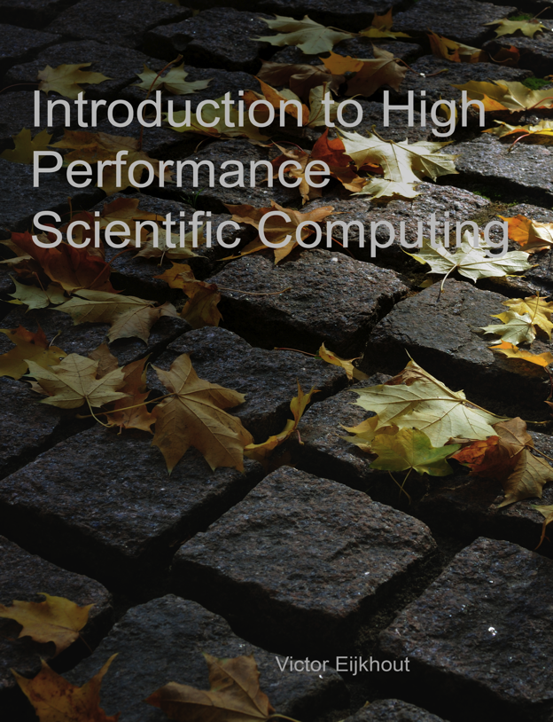
Further reading
General page: http://www.tacc.utexas.edu/~eijkhout/istc/istc.html
Direct download: http://tinyurl.com/EijkhoutHPC

Slide 46
Title
Text
code
Notes:
46

